Slide 1

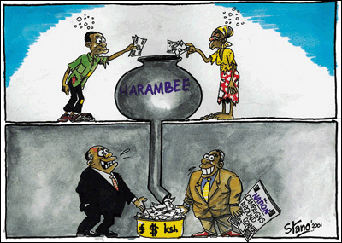
  CORRUPTION
      “RICH BECOMING RICHER…
      POOR BECOMING POORER”…

Slide 2
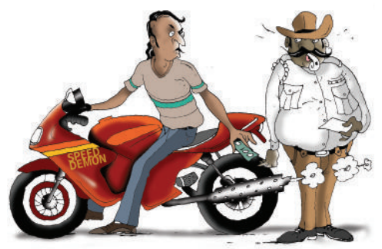
Corruption
“the misuse of public office for personal gains”
“as an act of bribery involving a public servant and a transfer of tangible resources”
“Corruption = Monopoly + Discretion – Accountability”
“An act x performed by an agent A is an act of institutional corruption if and only if:
x has an effect, E₁, of undermining, or contributing to the undermining of, some institutional process and/or purpose of some institution, I, and/or an effect, E_{c}, of contributing to the despoiling of the moral character of some role occupant ofI, agent B, qua role occupant of I;
At least one of (a) or (b) is true:
  A is a role occupant of I, and in performing x, A intended or foresaw E₁ and/or E_{c}, or A should have foreseen E₁and/or E_{c};
  There is a role occupant of I, agent B, and B could have avoided E_{c}, if B had chosen to do so.^{[19]}
Note that (2)(a) tells us that A is a corruptor and is, therefore, either (straightforwardly) morally responsible for the corrupt action, or A is not morally responsible for A's corrupt character and the corrupt action is an expression of A's corrupt character.”
Source: http://plato.stanford.edu/entries/corruption/

Slide 3
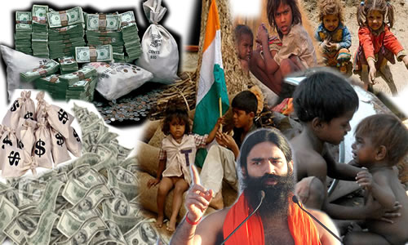
OUR INDIAN ECONOMY ?........
With 121crs of population
Nearly 26% of the poverty
14.02% of unemployment
24% of illiteracy
Corruption, bribe, etc..

Slide 4

Overview
Who corrupts?
Who is corrupted?
How?
What conditions facilitate corruption?
Corruption and business practice
Cultural differences

Slide 5
Who corrupts?
Multinational corporations
Organised crime
Government officials
Relatives
Friends

Slide 6
Targets
Personnel
Profits
Product
Process
Perimeter (border)
Popularity/ public image
Plans

Slide 7
Corruption
A study by Transparency International reveals that 55% of the Indians pay bribe for getting jobs in Public offices.
The public officials get bribes to the tune of 18.42 $bn.
The bribe constitutes 1.2% of GDP.
The bribe doubles each year.
According to the Swiss Bank Report, nearly Rs. 1456 Lakh crs of Black money is deposited.
There is an argument that if corruption be controlled, the development of India may become faster.
If it is taken back, people agree that there is no need to pay tax for next 20 years.

Slide 8
According to the data provided by the Swiss bank, India has more black money than rest of the world combined.
India topping the list with almost $1500 Billion black money in Swiss banks,
followed by Russia $470 Billion,
UK $390 Billion,
Ukraine $100 Billion and
China with $96 Billion.
An amount which is 13 times larger than the nation’s foreign debt

Slide 9
It’s been found that about 80 thousand people travel to Switzerland every year of which around 25 thousand travel frequently.
Those traveling on regular basis must be doing it for some reason.
Many state-funded construction activities in India, such as road building, are dominated by construction mafias, which are groupings of corrupt public works officials, materials suppliers, politicians and construction contractors.
Today, the number of ministers with an honest image can be counted on fingers.
At one time, bribe was paid for getting wrong things done but now bribe is paid for getting right things done at right time.

Slide 10
Corruption in India leads to promotion not prison.
It is very difficult to catch.
Corruption in India has wings not wheels.
As nation grows, the corrupt also grow to invent new methods of cheating the government and public.
Total loss to Indian Citizens –
Rs. 91060323430300000
Above is not the mobile number its minimum amount the corrupt Indians got it by doing corruption.
The recent scams involving unimaginably big amounts of money, such as the 2G spectrum scam, are well known.
It is estimated that more than trillion dollars are stashed away in foreign havens, while 80% of Indians earn less than 2$ per day and every second child is malnourished.

Slide 11
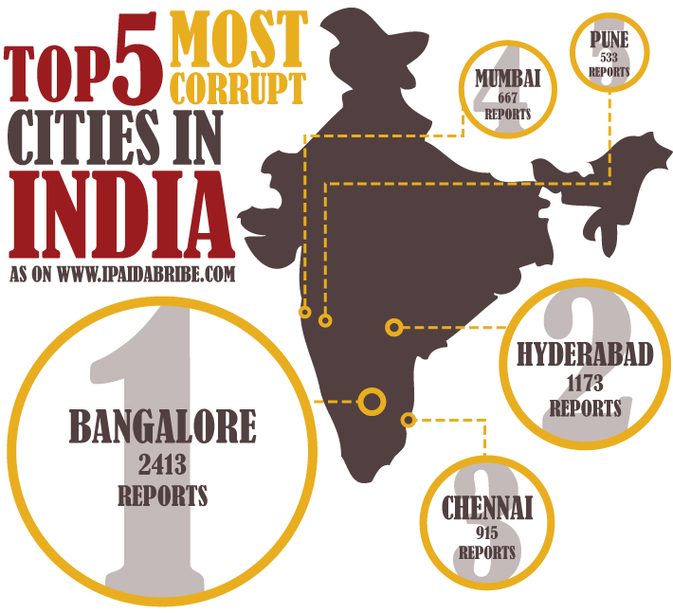

Slide 12
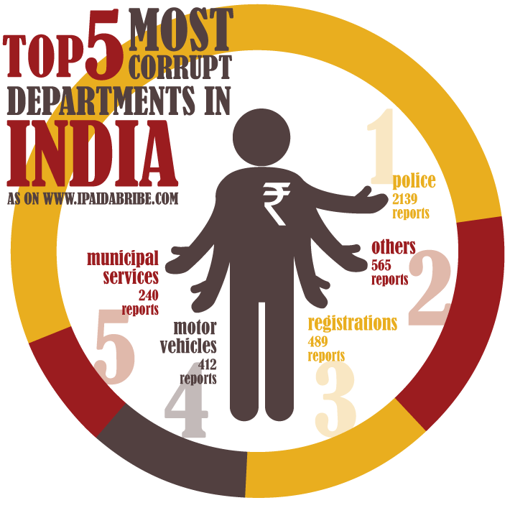

Slide 13
Areas of Corruption:
Prime Area : Hospitals
non-availability of doctors at PHCs;
even if posted, doctors do not stay at the PHC HQ;
inadequate physical infrastructure and facilities;
insufficient quantities of drugs;
lack of accountability to the public and lack of community participation

Slide 14
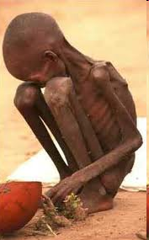

Slide 15
The government hospitals receives bribes at an average of 26.5% of the bills,
of these, urban government hospitals receives higher bribe.
Bribes are given to get doctor’s appointment,
for getting medicines,
to test in the diagnostic lab and for admissions for the ward.
44% of the government hospitals were giving prescriptions which are not connected to the diseases.

Slide 16
11.5% respondents in the India Corruption Study 2010 had paid a bribe for PDS
9% for hospitals,
5.8% for schools
4.3% for water supply.
a rural household paid around Rs 164 as bribe to avail of these four public services.
Rs. 8,830 million, in all, was paid as bribe by below poverty line (BPL) households in 2006-07
The poorest households of India paid Rs. 2,148 million to police as bribe in 2006-07
In Judiciary, of those who paid bribe, 28 percent paid bribe to get done routine jobs like listing of case or to get copy of documents.

Slide 17
        OUR POOR INDIA
        Almost 50% of households even in big cities like Bangalore and Hyderabad do not have sewerage connection;
        Only 21% of waste water is treated,
        as compared to 57% in South Africa;
        In about 80% of the rural households,
        the average water supply is less than 5 hours a day and
        over 70% of the household do not have access to toilets or sewage system;
        Out of 600,000 villages only 250,000 are free from open defecation.

Slide 18
        India accounts for 58% of the world’s population of open defecators.
        Though the government records claim that 88% of the Indian population has access to safe drinking water,
        only 31% are covered by proper sanitation facilities
        “Every year thousands of children die in India due to a lack of adequate sanitation and clean water.
        While some progress has been made, we continue to bear the true cost from the failure to ensure basic water and sanitation services.

Slide 19
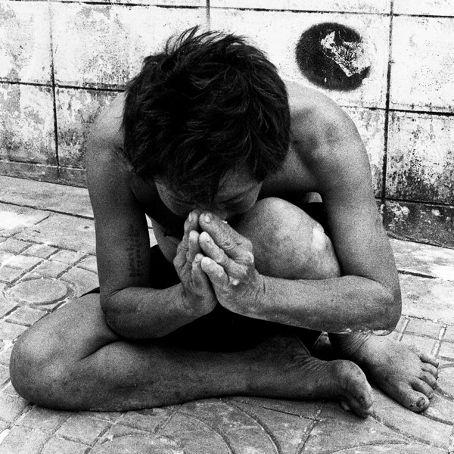
Please leave us…..

Slide 20
